Slide 1

ISBM College of Engineering, Pune
1
DRIVER DROWSINESS DETECTION
Group members:
Omkar mali (22)
Mayur borse (61)
Prashant koli (27)
Dhanraj gaikwad (64) guided by:
prof. balasaheb gite

Slide 2
CONTENTS
2
Domain
Introduction of Project Title
Problem Statement
Objectives
Requirements Analysis
System Architecture
Algorithms : 1] CNN Algorithm , 2] HAAR Cascade
Dataset and Classification
DFD Diagrams
Advantages and Disadvantages
Conclusion
References

Slide 3
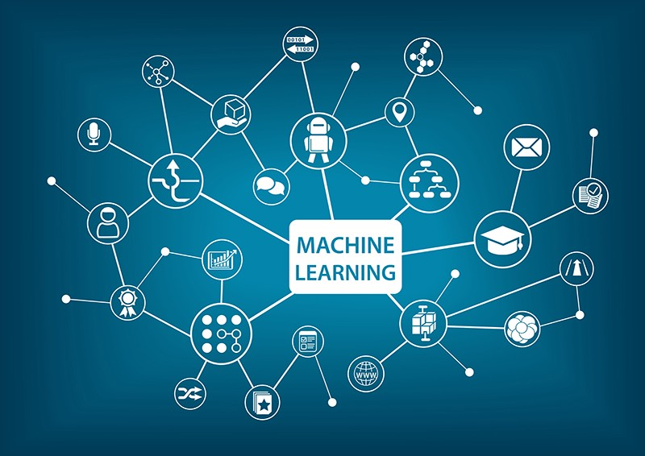
DOMAIN :- Machine Learning
3
Machine learning is an application of AI that enables systems to learn and improve from experience without being explicitly programmed.
Machine learning is a growing technology which enables computers to learn automatically from the past data.
Machine learning is an important component of the growing field of data science.
Machine learning uses various algorithms for building mathematical models and making predictions using historical data or information. Currently, it is being used for various tasks such as image recognition, speech recognition, email filtering, Facebook auto-tagging, recommender system, and many more.

Slide 4
INTRODUCTION OF PROJECT TITLE
4
Drowsiness is considered one of the major threats to road safety due to the fact that when a driver enters the microsleep state, the driver's unconsciousness will increase the possibility of causing accidents. Drowsiness can be attributed to the lack of sleeping, tiredness, or mental issues.
Many of the accidents occur due to drowsiness of drivers. It is one of the critical causes of roadways accidents now-a-days. Latest statistics say that many of the accidents were caused because of drowsiness of drivers.
For the prevention of this, a system is required which detects the drowsiness and alerts the driver which saves the life .

Slide 5
PROBLEM STATEMENT
5
The project employs a CNN model to determine whether or not a person is drowsy based on whether or not their eyes are closed or open. The idea has a direct application in the vehicle sector, making driving safer and lowering the number of people killed in car accidents caused by drowsy driving.

Slide 6
Objectives
6
First to design a system to detect driver’s drowsiness.
For enhancing safety , We are detecting the eye blinks of the driver and estimating the driver status. A safety technology that can prevent accidents that are caused by drivers who fell asleep while driving .
To detect drowsiness while driving and inform the driver at the appropriate time to avoid any mishaps .

Slide 7
LITERATURE SURVEY
7
Sr No. | Paper Name | Author , Publication , Year | Description
1. | IoT-Based Smart Alert System for Driver Drowsiness Detection. | Anil Kumar Biswal, Debabrata Singh, Binod Kumar Pattanayak, Debabrata Samanta. | This paper implements a mechanism to alert the driver on the condition of drowsiness or day dreaming. A camera monitors the driver’ eye blinking, eye closure, face detection.
2. | Real-time Drowsiness Detection Algorithm for Driver State Monitoring Systems | Jang Woon Baek, Byung-Gil Han, Kwang-Ju Kim, Yun-Su Chung, Soo-In Lee | The proposed algorithm detects the driver’s face in the image and estimates the landmarks in the face region.
3. | Eye Tracking based Driver Fatigue Monitoring and Warning System | Hardeep Singh , Mr. J.S Bhatia ,Mrs. Jasbir Kaur | The main idea behind this project is to develop a non-intrusive system which can detect fatigue of the driver and issue a timely warning.
4. | Machine Learning and Gradient Statistics Based Real-Time Driver Drowsiness Detection | Cyun-Yi Lin, Paul Chang, Alan Wang, and Chih-Peng Fan | The machine learning and gradient statistics based driver drowsiness detection is developed for the real-time application. The proposed system includes four parts, which are the face detection, the eye-glasses bridge detection, the eye detection, and the eye closure detection.

Slide 8
REQUIREMENTS ANALYSIS
8
SOFTWARE REQUIREMENTS
Operating System :- Windows 7 and above
Programming Language :- Python
IDE :- Jupiter Notebook
Hardware Requirements
System :- I3 Processor
Ram :- 4 GB (MIN)
Devices :- Web cam

Slide 9
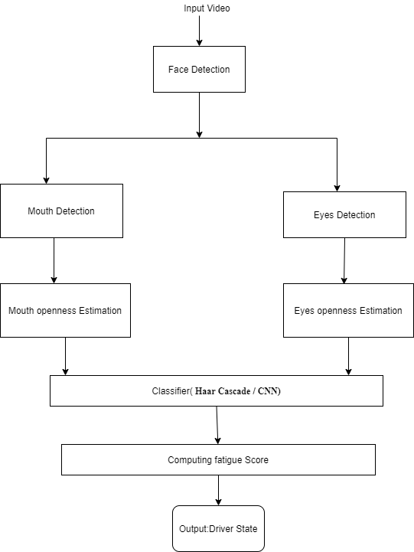
SYSTEM ARCHITECTURE
9
Architecture of the driver drowsiness detection system

Slide 10
ALGORITHMS
10
1] Convolutional Neural Network :
A CNN is a kind of network architecture for deep learning algorithms and is specifically used for image recognition and tasks that involve the processing of pixel data.
2] HAAR Cascade:
It is an object detection algorithm used to identify faces in an image or a real time video.

Slide 11
1] CNN ALGORITHM WORKING
11
Fetch the trained model from layer.
Loading the image of the same size as the one used in the training images.
Convert the image into an array.
Transform the numbers in the array to be between 0 and 1 by dividing by 255.
These are the steps used to training the CNN .
Step 1: upload dataset.
Step 2: the input layer.
Step 3: convolutional layer.
Step 4: pooling layer.
Step 5: fully connected

Slide 12
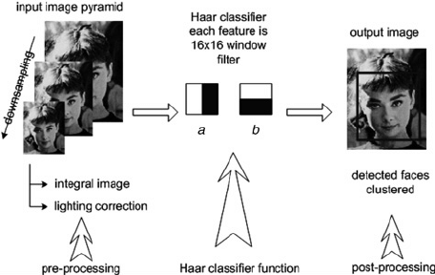
1] HAAR CASCADE
12
Haar cascade is an algorithm that can detect objects in images, irrespective of their scale in image and location. This algorithm is not so complex and can run in real-time. We can train a haar-cascade detector to detect various objects like cars, bikes, buildings, fruits, etc.

Slide 13
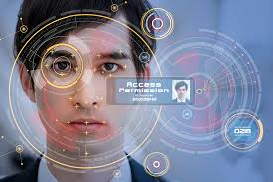
13
Step 1 – Take image as input from a camera.
Step 2 – Detect the face in the image and create a region
of interest (ROI).
Step 3 – Detect the eyes from ROI and feed it to the classifier.
Step 4 – Classifier will categorize whether eyes are open or
closed.
Step 5 – Calculate score to check whether the person
Is drowsy.

Slide 14
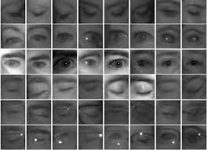
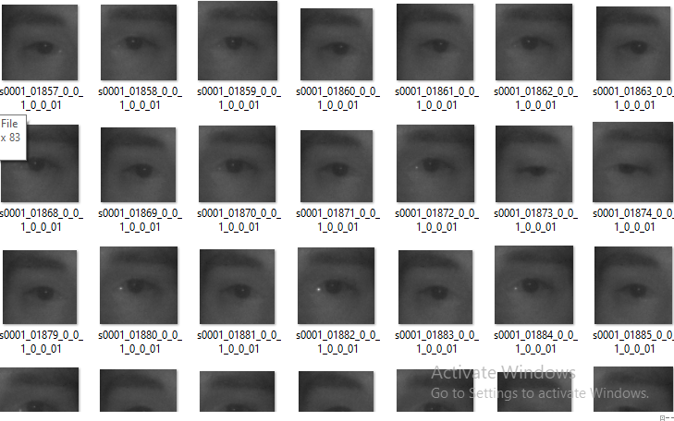
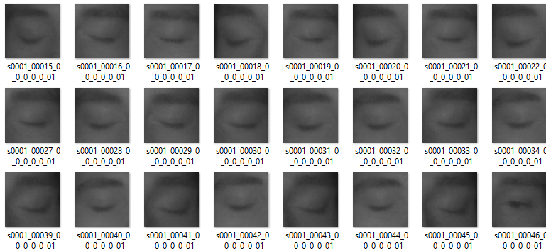
DATASET AND CLASSIFICATION
14
EYE DATASET
Open EYE Close EYE

Slide 15
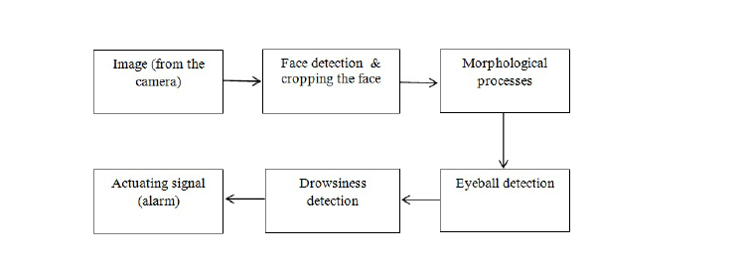
DFD DIAGRAM
15

Slide 16
16
ADVANTAGES
Driver drowsiness detection system is a car safety technology which prevents accident when driver is getting drowsy.
Driver inattention is might be the result of lack of alertness when driving due to drowsiness and distraction, the system alerts driver through alarm in real time.
Practically applicable .
Disadvantages
Lightening condition background

Slide 17
CONCLUSION
17
It completely meets the objectives and requirements of the system. The framework has achieved an unfaltering state where all the bugs have been disposed of. The framework cognizant clients who are familiar with the framework and comprehend it's focal points and the fact that it takes care of the issue of stressing out for individuals having fatigue- related issues to inform them about the drowsiness level while driving .

Slide 18
REFERENCES
18
https://medium.com/@nishthak36/driver-drowsiness-detection-using-machine-learning-ad79b15b14#:~:text=The%20Problem%20Statement's%20Description,eyes%20are%20closed%20or%20open
https://data-flair.training/blogs/python-project-driver-drowsiness-detection-system/
https://www.pantechsolutions.net/driver-drowsiness-detection-using-opencv-and-python

Slide 19
THANK YOU
19

